Slide 1

Varendra University
Dept. of Computer Science & Engineering (CSE)
Lab 4
Course Title: Microprocessor and Assembly Language Lab
Course No: CSE 334
Prepared By:
Md. Adnan Sami
Lecturer, Dept. of CSE, VU

Slide 2
Experiment Date: March 4, 2025
Experiment No: 04
Name of the Experiment:
Write some code in assembly language for Subtraction of 2 number using EMU8086.
Write some code in assembly language for multiplication of 2 number using EMU8086.

Slide 3
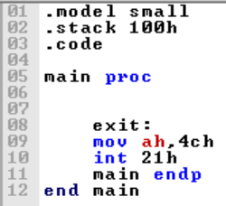
Return

Slide 4
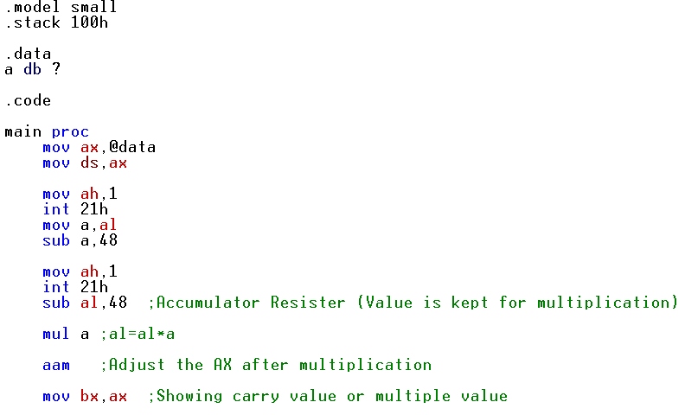
2. Write some code in assembly language for multiplication of 2 number using EMU8086.

Slide 5
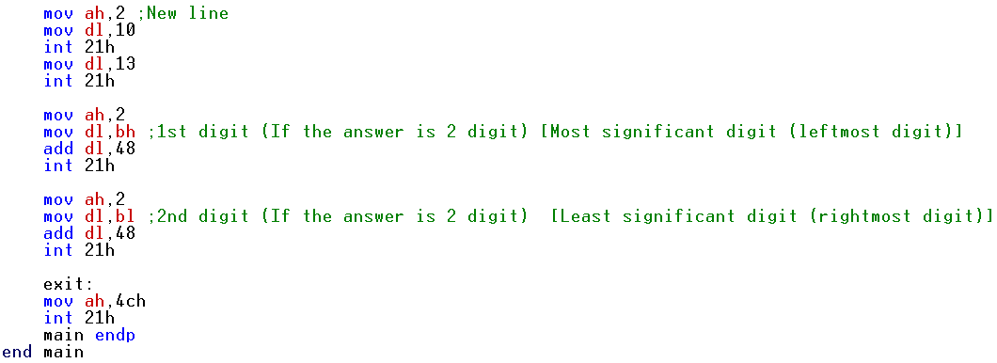
2. Write some code in assembly language for multiplication of 2 number using EMU8086.

